Slide 1
STRUCTURE OF THE WORLD ECONOMY TODAY

Slide 2
Introduction
From the late 1700s down to the present day there has been a world economy that has come to cover most of the earth’s surface.
The purpose of this lecture is to discuss how the world economy has evolved and the main characteristics of its structure (its bones and circulation system) today.
What are its main features?

Slide 3
Main Persistent Features of the Modern World Economy
1. Single world market
2. Politically fragmented “world of states” but not all equal
3. Three Geographical Tiers: Core, Periphery and Semi-Periphery
4. From Competitive to Organized (Fordist) to Disorganized (Post-Fordist) Capitalism from late 1960s
5. Varieties of “National” Capitalism
6. Temporal Trends/Cyclical Expansion and Contraction

Slide 4
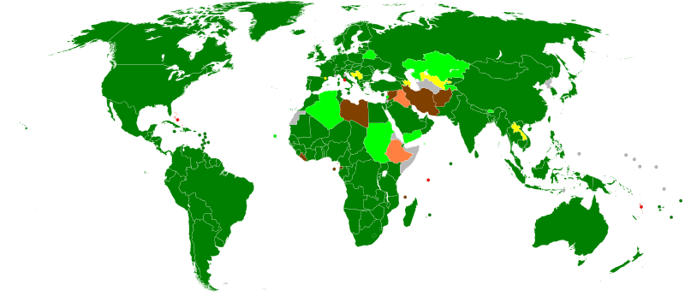
1. WORLD TRADE ORGANIZATION (2009)

Slide 5
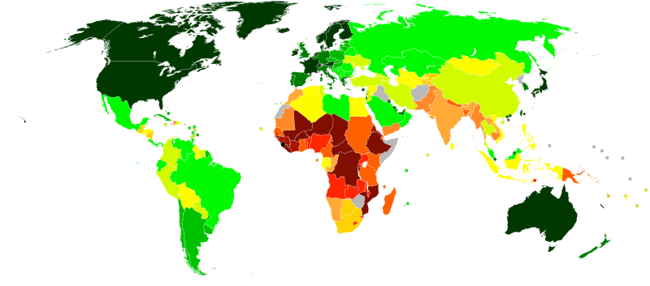
2. ECONOMIC COMPETITIVENESS (8 categories from dark green =most to brown=least)

Slide 6
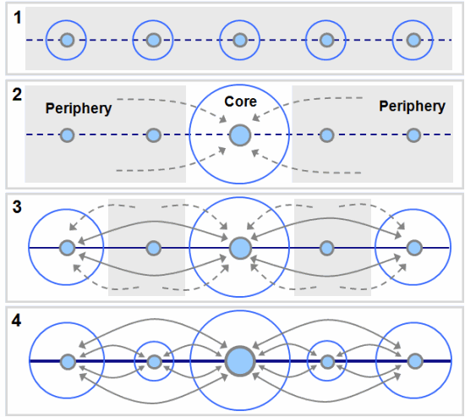
(3) GEOGRAPHIC TIERS

Slide 7
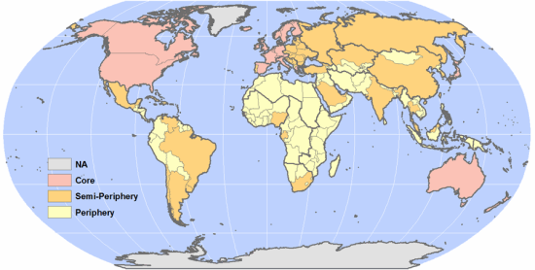
MAPPING THE THREE TIERS

Slide 8
(4) THREE ERAS OF GLOBAL CAPITALISM
Competitive (1500s-1840s), organized (1840s-1970), and disorganized (1970-) capitalism: nature of trade, investment, business organization, labor representation, work organization, role of national governments, and role of financial sector.

Slide 9
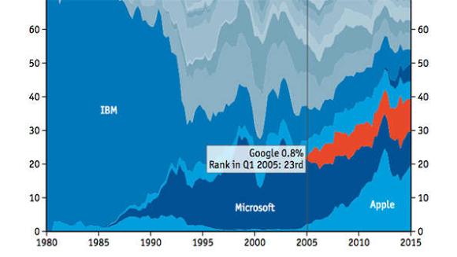
(a) From Organized to Disorganized? Firms.

Slide 10
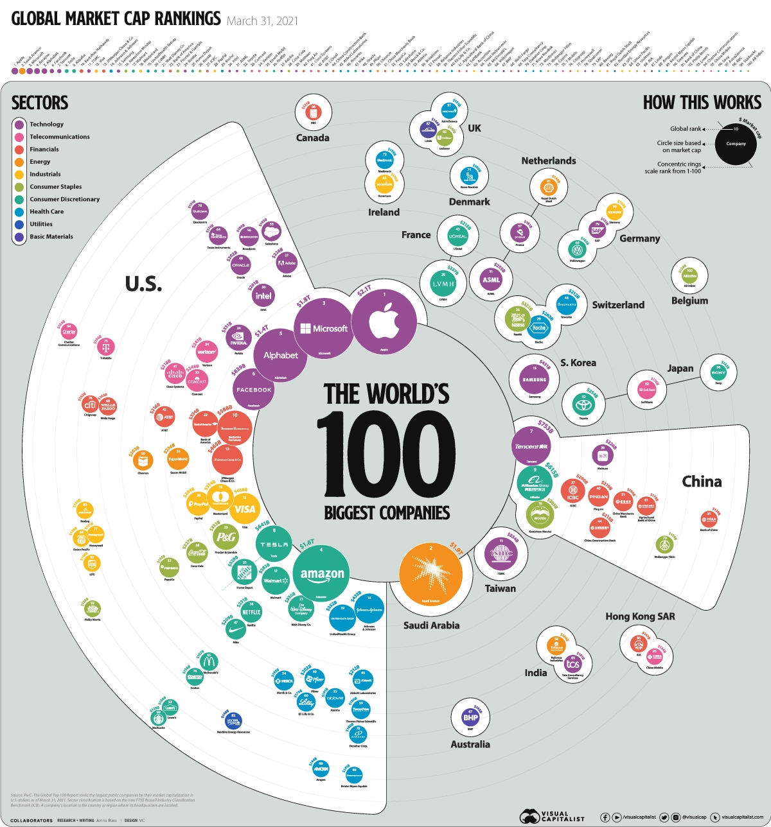
(b) The headquarters locations of the world’s largest companies (by market capitalization) 2021

Slide 11
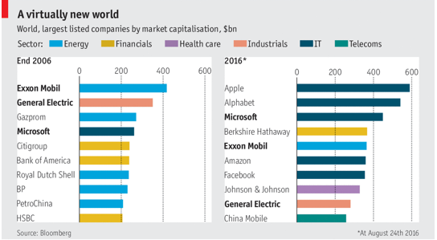
(c) The dynamics of disorganized capitalism (2006-2015): world’s largest companies by sector

Slide 12
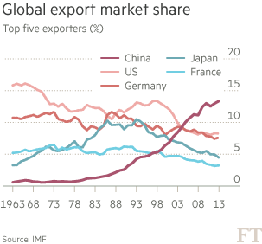
(d) From Organized to Disorganized? Countries.

Slide 13
(5) VARIETIES OF CAPITALISM (Selected Features, see Knox et al (2014) pp. 72-73))
American Japanese European British
Dominant Factor:
Capital Labor Partners Capital
Stock market:
V. Imp Unimp Unimp V. Imp
Welfare System:
Liberal Corporatist Socialdem Mixed

Slide 14
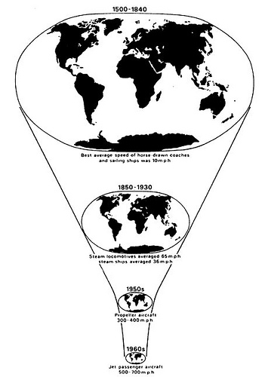
(6) TEMPORAL/CYCLICAL TRENDS (a) Time-Space Compression

Slide 15
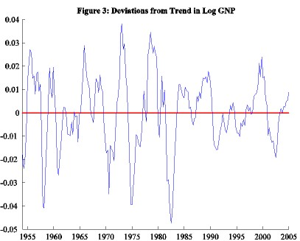
(b) Business Cycle (trends in total output)

Slide 16
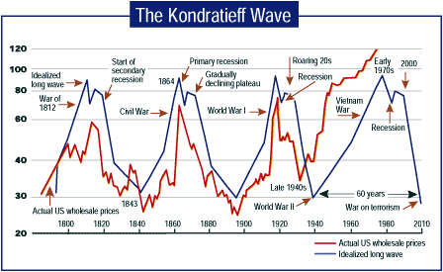
(c) The Long-Wave Cycle in Prices

Slide 17
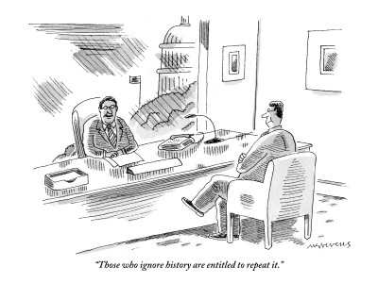

Slide 18
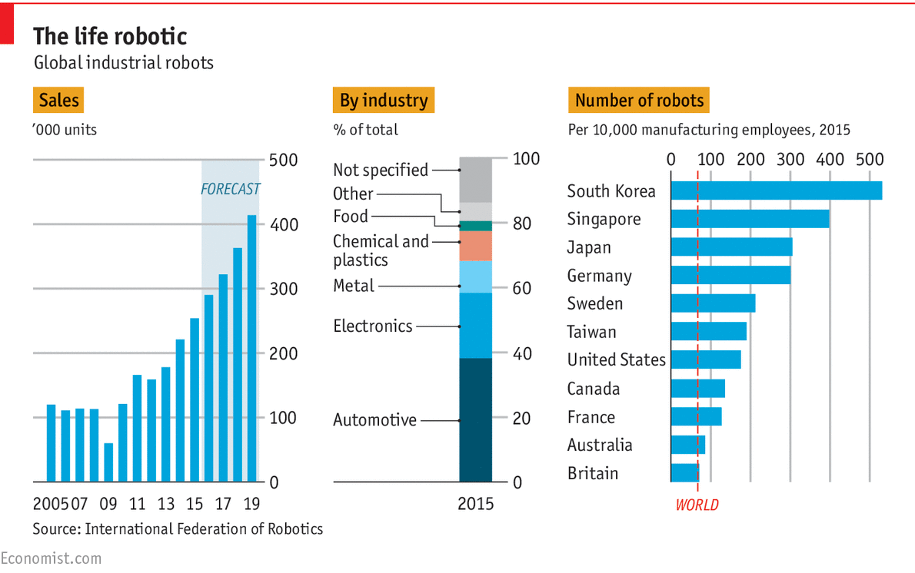
(d) Technology and “Creative destruction” (Joseph Schumpeter)

Slide 19
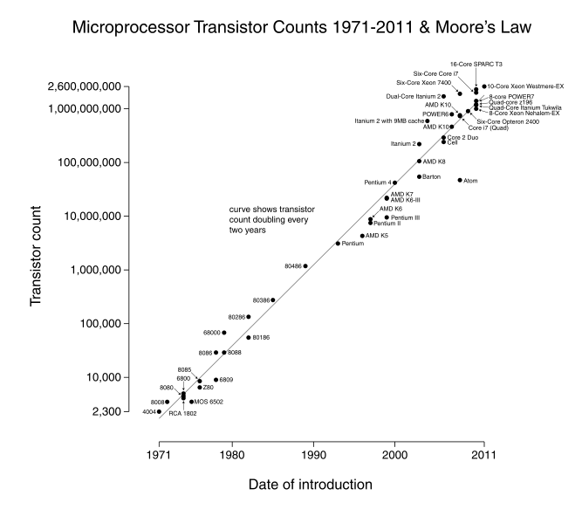
(e) Moore’s Law in IT

Slide 20
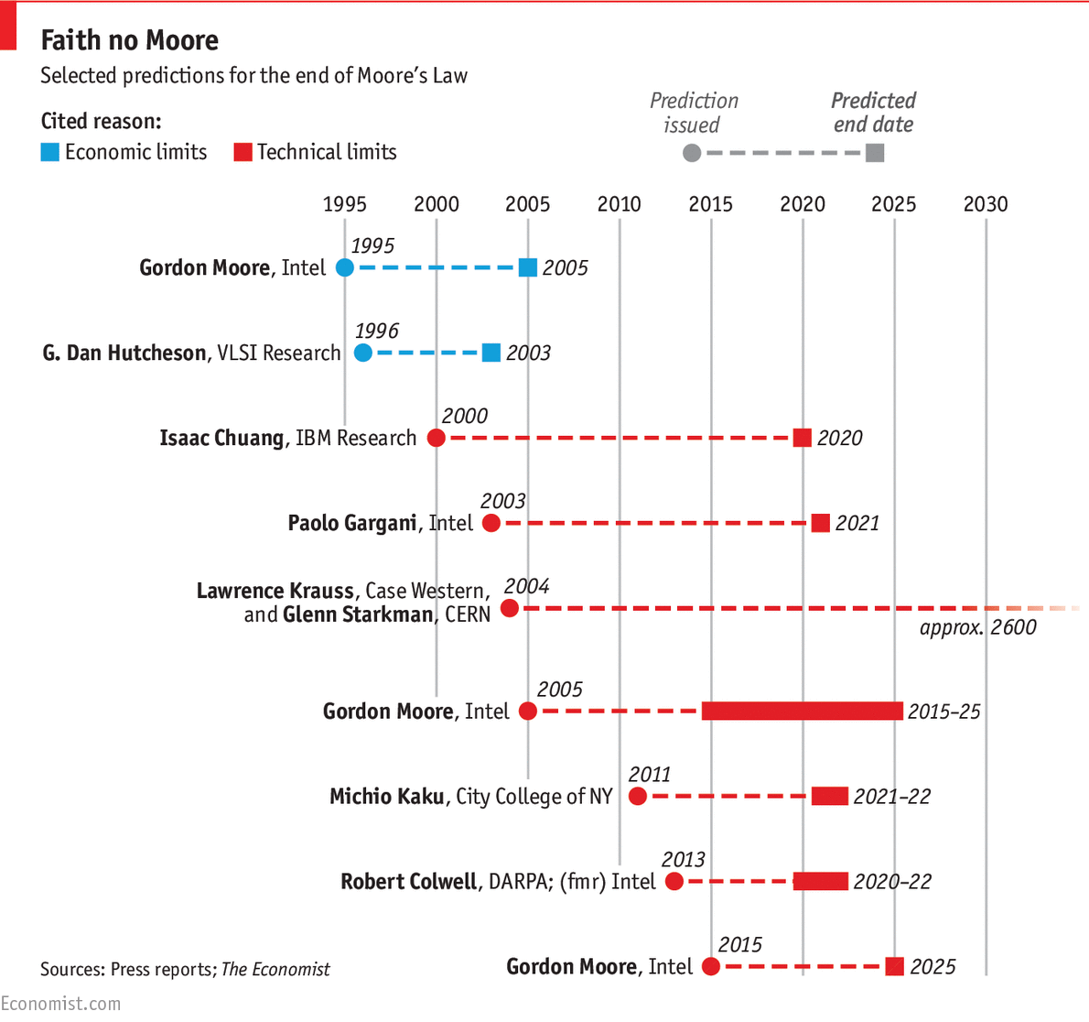
(f) The End of Moore’s law?

Slide 21
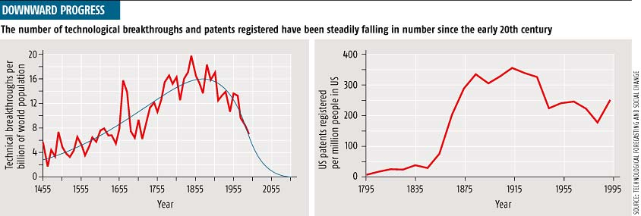
(g) Has technology peaked?

Slide 22
(h) Not so fast .. The Robots are still coming! (Greatest adoptions by largest companies in US and Europe)

Slide 23
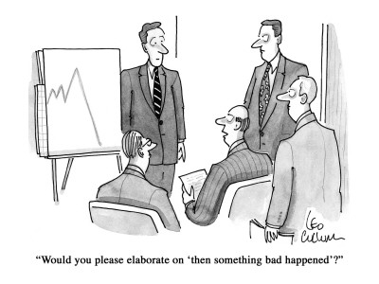

Slide 24
Conclusions
1. The modern world economy has had a number of common persistent features (increasingly a single worldwide market; politically fragmented; threefold geographical tiers; cyclical trend in prices driven by technological innovation)
2. But also some important trends that have not been persistent (from competitive to organized to disorganized capitalism; “national capitalisms” adapting differently to global trends; shortening business cycle; technology impacts lessening leading to weakening of long-wave cycle).
3. The rest of the course will examine how these varied features have played out across the world with some attention to late 1700s-1970 but mainly with a focus on the period since 1970. Examining the importance of the Industrial Revolution in Europe and then in the United States and Japan to the expansion of the modern world economy lays the foundation for the rest of the course.

